Slide 5
5,328,507,495,001 | 89.999° & 89.999° [3]
53,285,074,946,654 | 89.9999° & 89.9999° [4]
532,850,748,720,583 | 89.99999° & 89.99999° [5]
5,328,507,541,438,158 | 89.999999° & 89.999999° [6]
53,285,076,092,285,976 | 89.9999999° & 89.999999° [7]
532,851,032,084,760,704 | 89.99999999° & 89.9999999° [8]
5,328,483,204,781,702,144 | 89.999999999° & 89.999999999° [9]
53,286,865,820,032,589,824 | 89.9999999999° & 89.9999999999° [10]
532,868,658,200,325,849,088 | 89.99999999999° & 89.99999999999° [11]
5,369,676,478,787,898,834,944 | 89.999999999999° & 89.999999999999° [12]
52,354,345,668,182,016,000,000 | 89.9999999999999° & 89.9999999999999° [13]
76,151,775,517,355,664,211,968 | 89.99999999999992° & 89.99999999999994° 00.00000000000003° [14]
418,834,765,345,456,128,000,000 | 89.99999999999999° & 89.99999999999999° [15]
89.00000000000003

Slide 6
How did Hubble spot the most distant star yet?
12.9 Billion Light-years =
75,834,267,314,100,000,000,000
https://www.calculator.net/triangle-calculator.html
https://www.aldebaran.cz/bulletin/2004_17/pdf/measure.pdf
12.9b LY converted to Parsecs: 3955157980.0661
Which comes to a parallax angle of 2.528344e-7 milliarcseconds (0.0000002528344 milliarcseconds)
Which converts to a distance of 3.955e+9 parsecs, which converted to light-years is: 12,899,484,737.94
So we're off by just a bit on the triangle with 89.99999999999992° & 89.99999999999994° angles.
Explanation of Parallax and Arcseconds
Parallax method of measuring distance to stars
Gaia Parallax Data Set. It all comes from a space telescope. How is the accuracy verified if nobody can measure it except for Gaia?
https://www.translatorscafe.com/unit-converter/en-US/calculator/parallax-distance/?p=88.83&pu=mas&star=Arcturus
https://www.wolframalpha.com/input?i=1.29+%C3%97+10%5E10

Slide 7
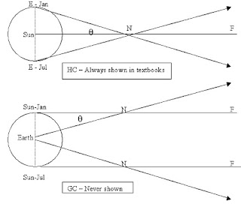
Stellar parallax 1832
Parallax :
position shift of 2 objects
relative to a 3rd.
reference line is S-N-F
Notes:
10- MS proof of HC: HC done in April HW: find the GC model ref ….. theta same for both
An example of kine…so relative measurement.

Slide 10
v/c=θ (v = 30km/s, θ=20”, c = SoL )

Slide 11
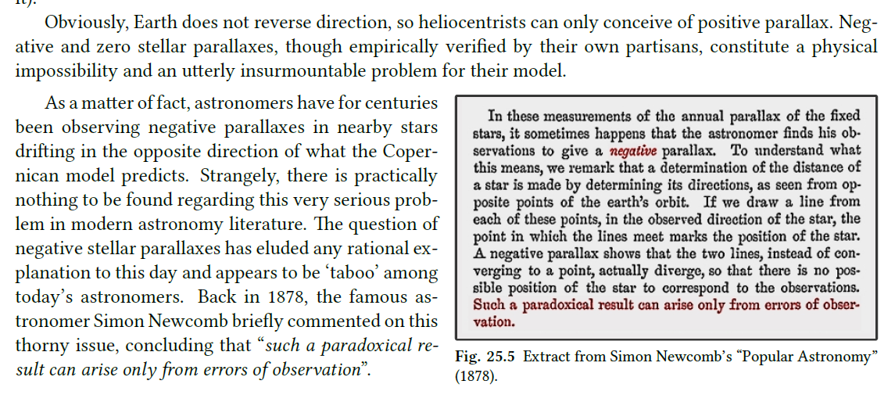

Slide 12
Fig. 25.9 .e“Hipparcos satellite” as depicted at official NASA website. [9]

Slide 13
Notes:
Can’t just absorb them as positives because the calculation would be physically meaningless
Can’t remove them or adjust them uniformly because it creates a bias
If you have to make changes, use Bayesian method (don’t mess up the canonized lore)

Slide 14
https://publish.obsidian.md/shanesql/Library/69+Miles+Per+Degree%2C+you+say

Slide 15
Variance in c at altitude; can’t use for a ratio for celestial obs velocities

Slide 18
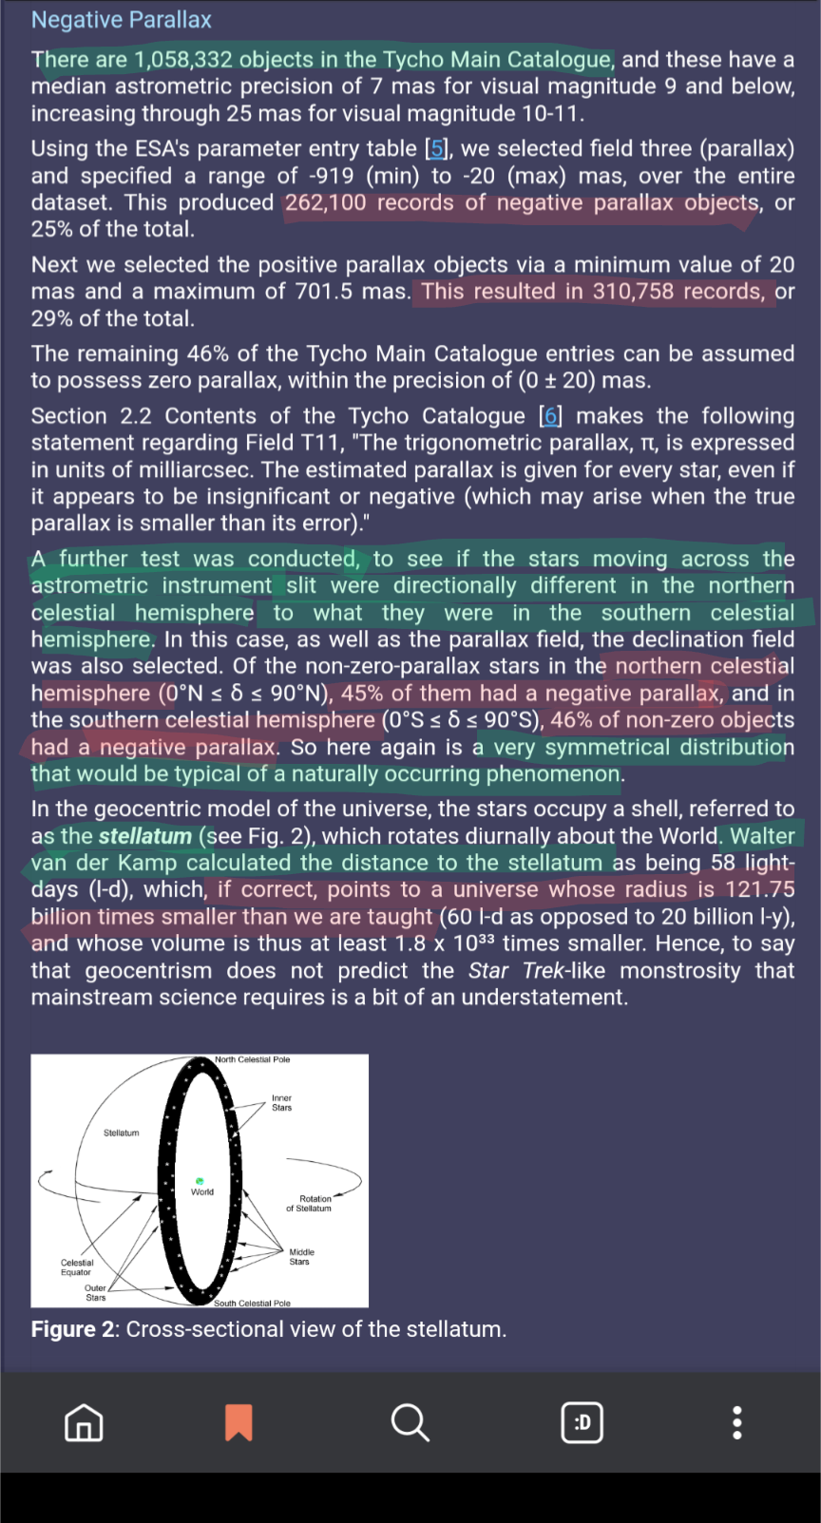

Slide 19
Notes:
Toroidal optics [brief]
Stellar Ab
Motion in the sk
Curved visual space / Vieth-Muller-Circles

Slide 21
https://youtu.be/HV89DJhCsCE?list=PLoeKBeKeoPx40rW9i-tSOB0Si1TW4Mkvp&t=4756
Notes:
https://youtu.be/HV89DJhCsCE?list=PLoeKBeKeoPx40rW9i-tSOB0Si1TW4Mkvp&t=4756

