Slide 1
Faster East -> West Electromagnetic Propagation
The Sagnac Effect in GPS

Slide 2
Summary of the Argument Before Breaking Down the Components
Variance of c:
The variance of c is revealed when measured in a preferred reference frame, which is the ECI: a frame that’s stationary and non-rotating with respect to rotation on Earth’s surface (or ether wind). This measurement is performed using a range measurement equation and a time interval system, such as GPS.
Preferred reference frame:
The discrepancy arises when transforming distance derived from the range measurement equation in the ECI to the ECEF. It shows that the value of c in the ECI is not equal to the value of c in the ECEF. If c were truly invariant in all reference frames, the distance derived would also be invariant under transformation as well.
The General Principles of Covariance:
A violation of Lorentz covariance contradicts the mathematical framework and rules therein which govern the laws of physics during coordinate system transformations. Consequently, such a violation falsifies the first two postulates of Special Relativity and undermines any philosophical explanations derived from the mathematics, such as length contraction and time dilation. These explanations become unnecessarily and revealed to be reifications anyways.
Principle of Relative Simultaneity invalidated:
There’s the conflict between so-called “Global” Simultaneity and so-called Relative Simultaneity. Another Special Relativity principle by which GPS’ accuracy explicitly functions on by violating it.

Slide 3
Definitions
Sidereal – Earth’s daily rotation with respect to the fixed stars

Slide 4
What is Ether Wind

Slide 5
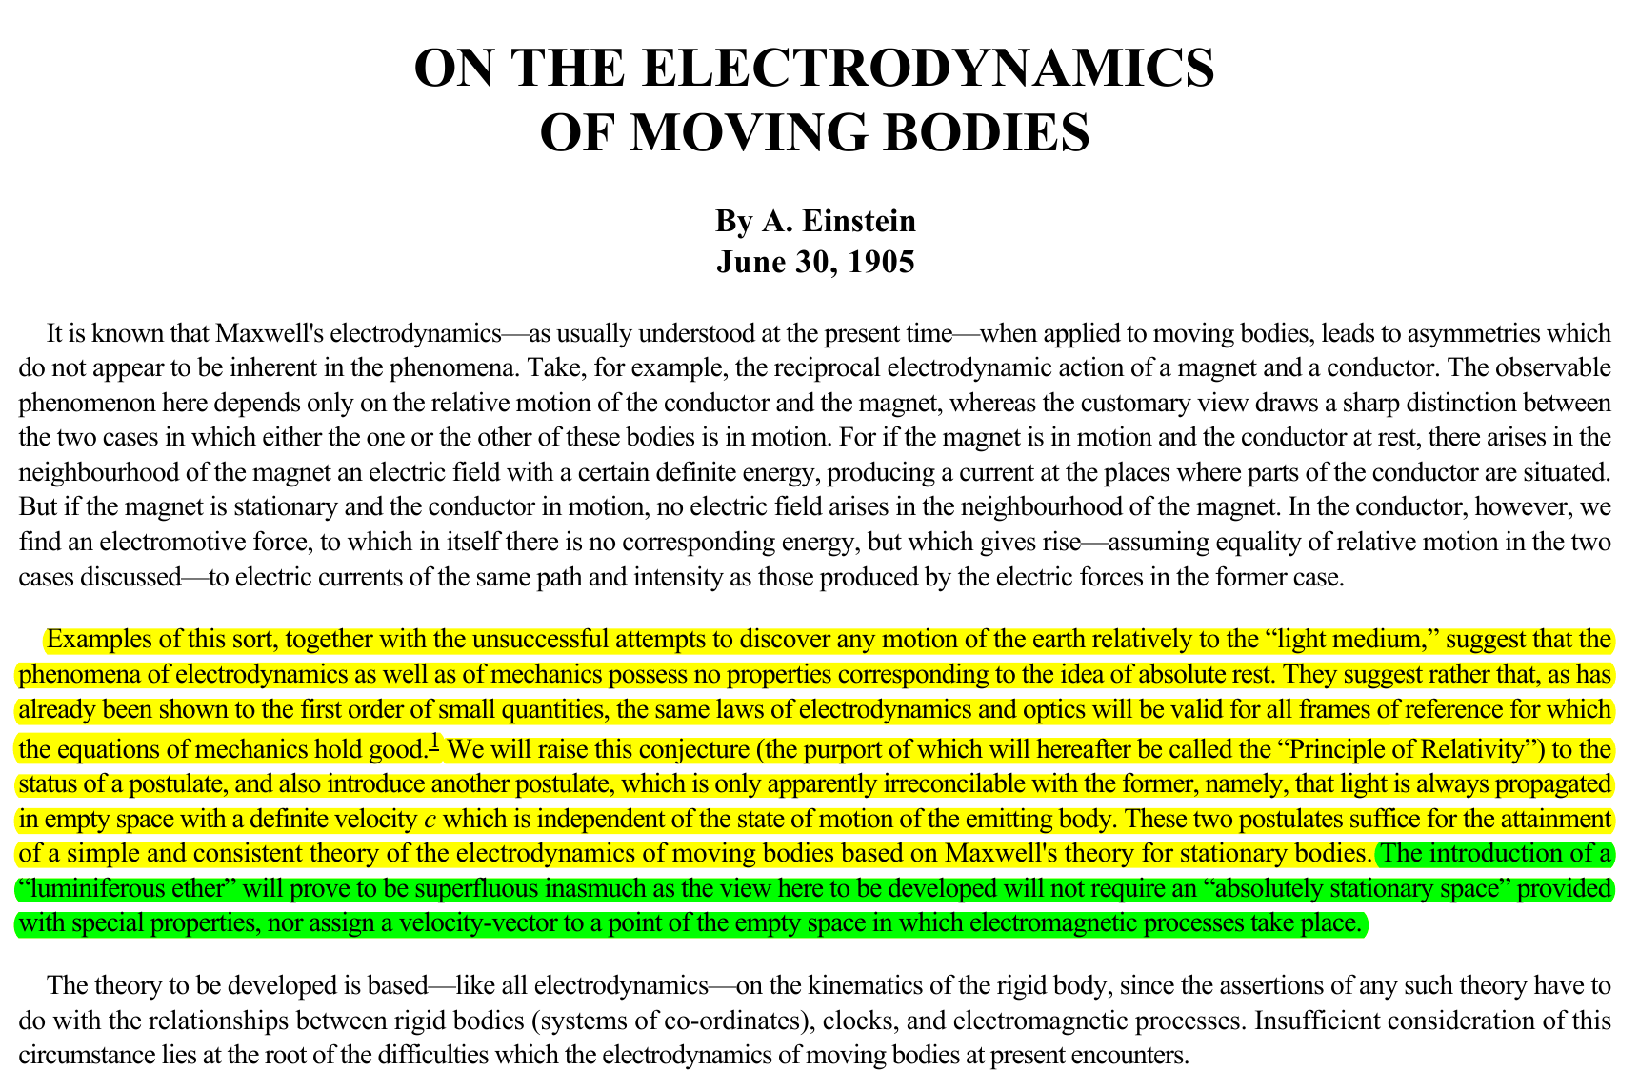
SR Postulates

Slide 6
Special Relativity Postulates: Commentaries
In the analogy presented by Einstein, he explains that regardless of Earth's motion, the null result of the Michelson-Morley experiment (MMX) is predicted by Special Relativity because the speed of light is invariant. This means that the speed of light remains the same in all inertial frames of reference and therefore no fringe pattern would be detected if the Earth is in motion.
In the case of the electrodynamic relationship between the respective motions of magnetic field and conductor, when the magnet is in motion and the conductor is stationary, the magnet's motion generates an electric field, which interacts with the conductor, inducing an electromotive force (EMF) and subsequently an electric current.
Conversely, the inverse relationship between a stationary magnetic field and a conductor in motion, the induced magnetic field and the original magnetic field results in a force known as the Lorentz force. The Lorentz force opposes the motion of the conductor, following the principles of conservation of energy. The thing to note here is that regardless of the motion, an effect is observed.
Einstein’s conclusion based on this electrodynamic relationship with motion, Einstein postulates that all reference frames are equally valid and that there’s no preferred reference frame. A summary of that summary’s summary:
SR is conceived through co-opting the Michelson-Morley experimental which failed to produce a fringe shit reading corresponding to a velocity of 30km/s. To their dismay, a reading of *5km/s to *7/kms was given. To explain this, the measured fringe is attributed to instrumental error instead of a velocity reading. With the results being considered a “null” in this regard, it is claimed, unsubstantiated of course, that because the Earth is assumed to in motion around the sun, there must not be a stationary ether to measure relative motion from as an absolute reference frame. By claiming the fringe was effectively zero, the experimental results could be interpreted as proof that c is invariant regardless of motion of the source or observer.
Regarding Einstein's comparison of the respective motions of the stationary and moving magnets and conductors, another postulate is formed: All reference frames regarding electromagnetic phenomena and optics are equally valid. Regardless of your reference frame regarding the moving and/or stationary magnetic and conductor the effect produced regardless of their respective motions, although by different mechanisms.
The claim here is that the speed of light is the same regardless of the motion of source or observer and that the electrodynamics of moving bodies provides a good analogy to describe the concept of reference frames and how the laws of physics must be the same in all of them and that none of them are preferred because for one reason or another, the desired effect will be relativistic.
*Not actual velocity. The velocity provided in MMX is to a scaled specifically to be able to interpret Earth’s orbital velocity, it is not a velocity set in stone. Technically they could have made 1 fringe = 30km/s and claimed they got their detection.

Slide 7
SR Postulates

Slide 8
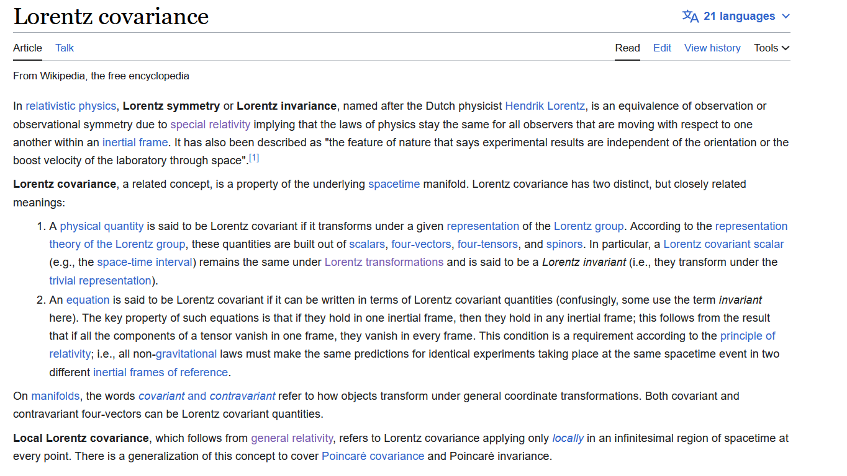
Transformations and Covariance
Rules for coordinate systems and transformations
https://en.wikipedia.org/wiki/Lorentz_covariance
https://en.wikipedia.org/wiki/Inertial_frame_of_reference

Slide 9
Definitions:
A reference frame is a mathematical presupposition described by a coordinate system. Using a defined set of axis (x, y, z, t), the position and motion of objects within that coordinate system allows you to describe the physical quantities and phenomena within that reference frame [coordinate system].
Transform: To transfer information such as variables representing the laws of physics and other values to another coordinate system. In this case, c, the speed of light, is a law of physics and should be invariant under transformations.
Mathematically, the laws of physics are invariant under transformation between coordinate systems. This concept is known as transformation invariance or covariance.
This means that the form of the laws remains the same regardless of the specific coordinate system chosen to represent the physical phenomena. This principle is crucial in ensuring that the laws of physics hold true in all reference frames and under different reference frames.

Slide 10
Transformations and Covariance [non-invariant vs invariance]

Slide 11
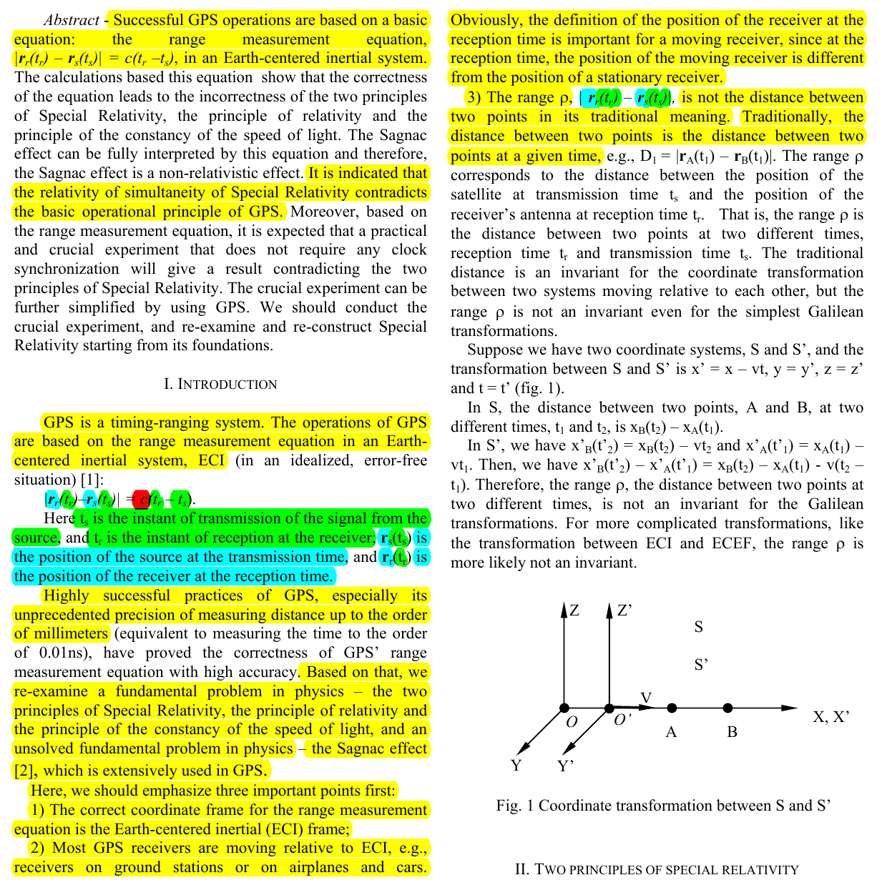
Mathematic structure violation
The c in the ECI shown to not be the same c when transferred to other coordinate systems when it should be invariant under transformations according to Lorentz covariance.
Going all the way back to Michelson-Morley, this non-invariance issue invalidates the justification to assume c and then transform to a new reference frame to ad-hoc explain the variance shown in the Michelson-Morley experiment.

Slide 12
Reference Frames: ECI and ECEF

Slide 13
Reference Frames: ECI and ECEF
ECI = Stationary non-rotating (fixed) earth with respect to a rotating sky (ether). Motion in this frame is absolute because it's with respect to a fixed position.
It is in the ECI reference frame that the speed of light (EM propagation) has a preferred direction and is received by the observer with a delay that’s directly proportional to the observer’s velocity.
ECEF = Rotating frame where motion is relative to the Earth's rotation with respect to the fixed stars

Slide 14
ECEF
A three-dimensional cartesian coordinate system with the origin at the Earth’s center of mass and rotates with Earth’s surface, with respect to the fixed stars. This coordinate system can be used to
define a location on the surface of the Earth or in space, i.e. the location of a satellite relative to Earth’s rotating surface.
Equatorial plane is the x-axis intersecting with the center of the ECEF.

Slide 15
Variance of c
Recalling that GPS is a time interval system that derives distance by using an assumed fixed value for c, the time difference between signal transmission time and signal reception time difference is multiplied by c. In its respective coordinate system, c is shown to have a preferred direction of propagation, east -> west [west -> east on a globe]. This effect is attributed to the Sagnac effect and is said to be the equivalent of the signal receiver rotating into or away from the transmitted signal, which is causing the varying speed.

Slide 16
How distance is traditionally derived:
Traditional distance equation D₁ = |r_{A}(t₁) - r_{B}(t₁)|
D₁ = Distance between A and B at time represented by t₁.
r_{A}(t₁) = The position vector of point A at time t₁. The position vector typically consists of three components (x, y, and z) representing the coordinates of point A in a three-dimensional space.
r_{B}(t₁) = The position vector of point B at time t₁. Similarly, to r_{A}(t₁), it consists of three components (x, y, and z) representing the coordinates of point B in a three-dimensional space.
r_{A}(t₁) - r_{B}(t₁) = The difference between the two position vectors of point A and B.
This derives distance between two points at the same time. The traditional distance equation D₁ = |r_{A}(t₁) - r_{B}(t₁)| calculates the distance between two points (r_{A} and r_{B}) at the same time (t₁). It does not involve measuring the time difference between events like the GPS range equation does.

Slide 17
Range Measurement Equation
GPS’ Range Measurement Equation: |r_{r}(t_{r}) - r_{s}(t_{s})| = c(t_{r} - t_{s})
This derives distance by measuring the time difference between two events (i.e., transmission time (t_{s}) and receiver time (t_{r})
GPS range equation considers the time delay between transmission and reception to determine distance, while the traditional distance equation measures the spatial separation between two points at a specific moment in time.
t_{s} = Time of transmission of the signal from source
t_{r} = Time of reception at the receiver
r_{s}(t_{s}) = ECI coordinate system position of the source at the transmission time
r_{r}(t_{r}) = ECI coordinate system position of the receiver at reception time
c = the invariant speed of light; independent of source of receiver; ~300,000 km/s
|r_{r}(t_{r}) - r_{s}(t_{s})| represents the range, which is the distance between the position of the receiver at reception time: r_{r}(t_{r}) and the position of the source (satellite) at transmission time: r_{s}(t_{s})
= c(t_{r} - t_{s}) The range is directly proportional to the time difference t_{r} - t_{s} and the speed of light, c.
Here the ECI serves as a stationary non-rotating reference frame for the relative speed of electromagnetic propagation to be measured so that distance can be derived by determining the absolute values of the locations and time of the signal source and signal receiver in the ECI coordinate system and subtracting the time difference from c. Using the ECI reference frame, the variance of c can be used to determine distance in this coordinate system. In this equation with the ECI, the relative velocity of c is being measured with respect to an absolute frame.
If all reference frames were truly equally valid as per the postulates of Special Relativity; then the distance derived from the range measurement equation in the ECI, being proportional to an invariant speed of light (c), should be invariant when transferred to another coordinate system that uses c as invariant. However, it shown that when transferring to another coordinate system distance must be again corrected, this time within the confines of relativistic effects, i.e., time dilation, length contraction, etc.
The accuracy of GPS is dependent on absolute reference frame to measure the relative speed of electromagnetic propagation against. The preferred reference frame (stationary, non-rotating) is the frame which all other frames are derived. The variance of c shows that there is an absolute background that sets the speed of propagation for light and is shown in the preferred direction West -> East.

Slide 18
Visual difference between a time interval system and traditional distance derivation

Slide 19
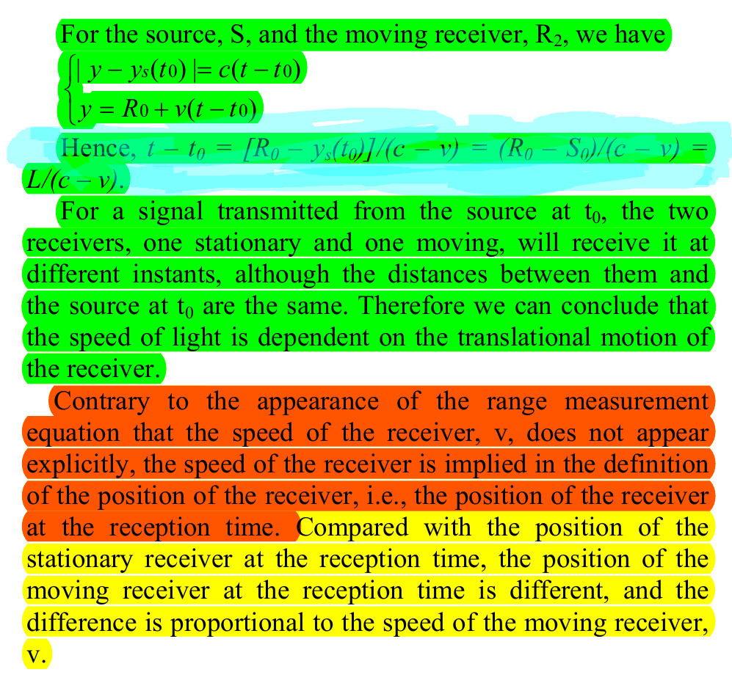

Slide 21
GPS Time and Atomic Clocks
Do atomic clocks account for relativistic effects? What is a relativistic effect?
Atomic clocks account for electromagnetic retardation. They’re calibrated to a specific rate of oscillation by microwaves being focused on the cesium and then along with the magnetic field, a “known” oscillation rate can be artificially maintained so that a very precise measurement of time can be made.
GPS uses its own timing system called GPS time. Atomic clocks have nothing to do with “time dilation”. In fact, in Hafele-Keating, the clocks going with the rotation of the sky became of out sync at higher rates than going opposite. If anything, that experiment also shows a preferred direction.

Slide 22
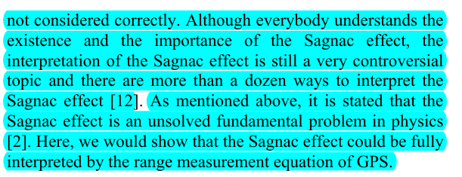
The Sagnac Effect

Slide 23
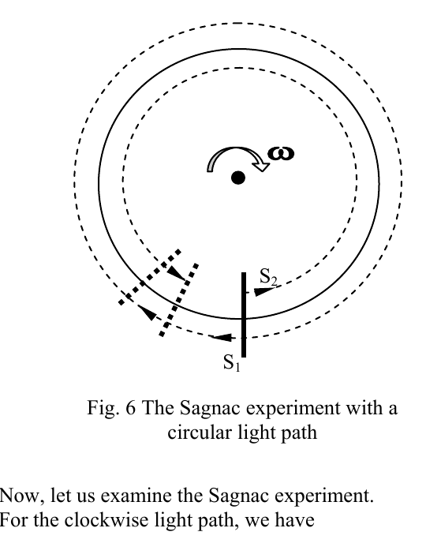
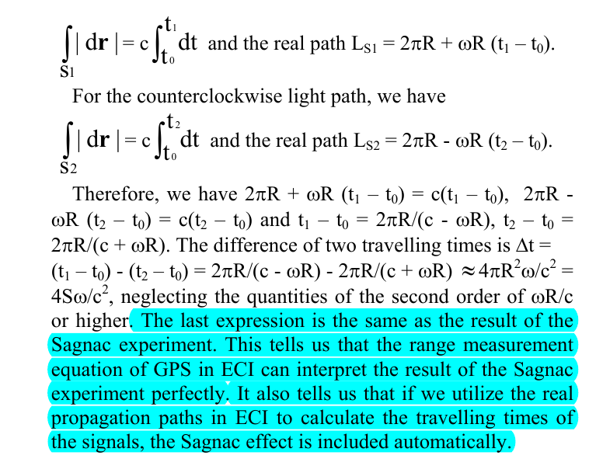
Sagnac Effect Derived from the RME [no relativistic effects here]

Slide 24
Sagnac Effect Linearized

Slide 25
Sagnac Effect Linearized
Circular:
∆t = 4ΩA/cλ
Linear:
∆t = 2vl/cλ

Slide 26
Sagnac effect is a non-relativistic effect. The Sagnac effect is directionally dependent.
The Sagnac effect is not an effect due to angular rotation. The confines by which General Relativity attempts to co-opt the Sagnac effect is invalidated. Without GR’s angular rotation solution provided by, there’s no mechanism to explain the effect within relativistic means.
Wang demonstrates that in an inertial reference frame, there’s a varying speed of light. This violation of Special Relativity’s postulates renders the framework untenable and unable to answer the Sagnac effect without ignoring the fact that c objectively varies in a preferred reference frame.
This means that the Michelson-Morley experiment was not a null result or instrumental error. The velocity scale in which they applied to the fringe patterns was off. Michelson-Gale and Sagnac are essentially the same experiment as Michelson-Morley. If Michelson-Gale and Sagnac detected a fringe corresponding to the sidereal rotation, then Michelson-Morley must also be a valid detection. The only difference here is the scale invoked to interpret the result for an orbital velocity.
Therefore: It’s completely unjustified to Lorentz transform to a reference frame of an observer on the sun to theoretically explain length contraction that would have already happened in our frame to derive the correction needed to infer Earth’s alleged orbital velocity of 30kms/s from a 5km/s reading and then to turn and use the same fringe reading as 15°/h and correlate it to Earth’s alleged rotation relative to the latitude.

Slide 27
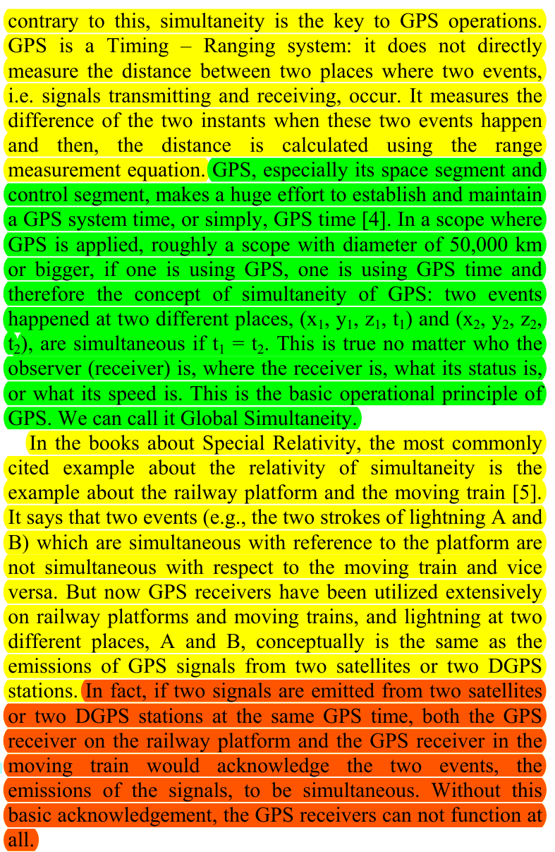
Relative Simultaneity vs “Global” Simultaneity

Slide 28
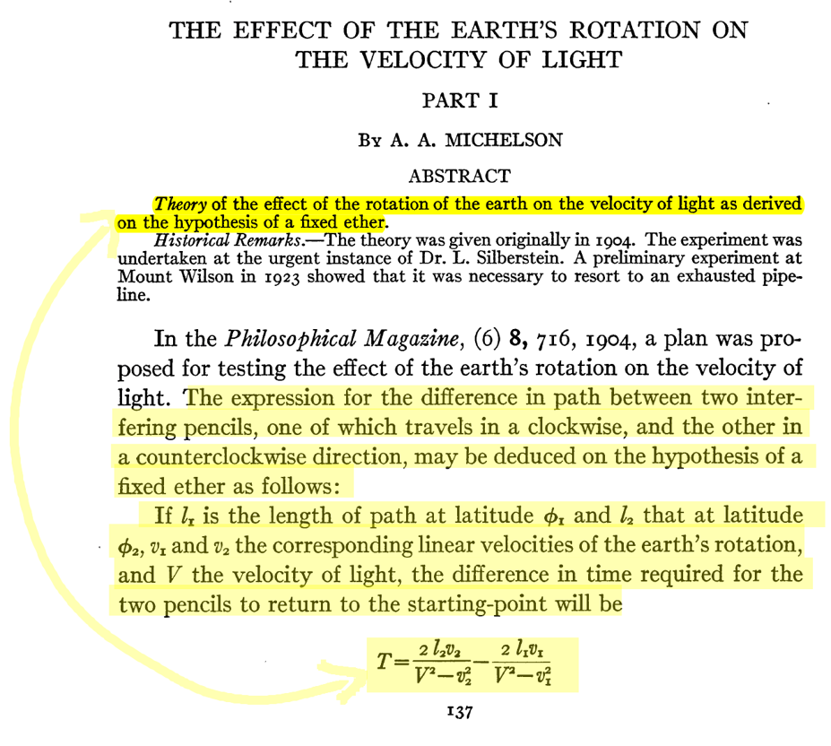
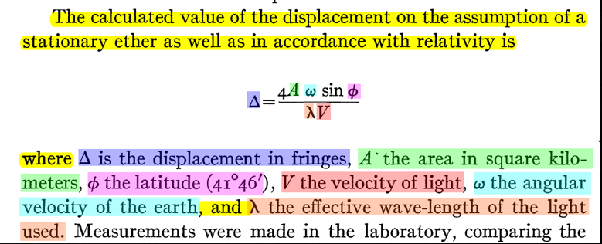
Michelson-Gale-Pearson [1923]
The speed of light relative to what? The Center of Earth’s or the ether vortex? The varying speed of light is shown here in Michelson-Gale to mathematically derive the results by measuring the difference in c in the N/S and E/W pipes, relative to one another, respectively. The implication of a preferred frame to measure the relative velocities against that produces the accurate measurement of the variance speed of light, as it’s the only one that produces the results
Does relativity predict a varying speed of relative to the translation motion of the observer?

Slide 29
What is responsible for c’s Variance: Orbital Velocity vs Earth Rotation
Another complete failure for the Heliocentric model is that Earth’s orbital velocity isn’t added to compensate for the linear motion experienced when the Earth is rotating into its orbit around the sun. If the claim is that the linear motion of Earth’s rotation what’s being accounted for, then Earth’s orbital motion must also be accounted for.

Slide 30
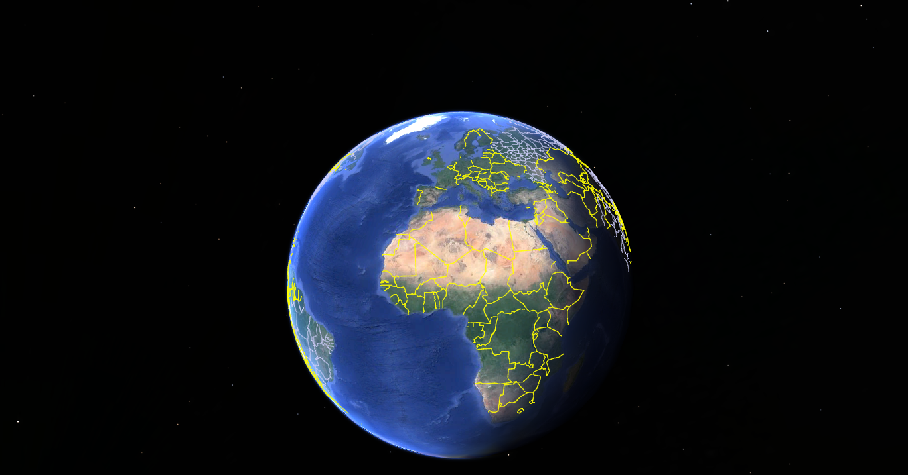
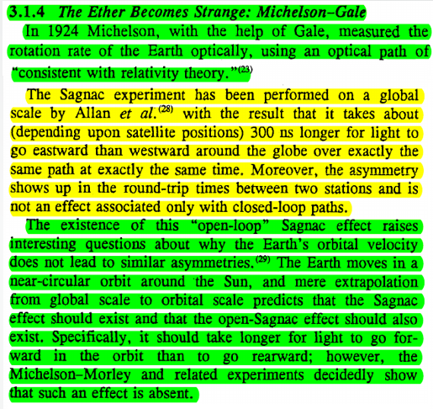
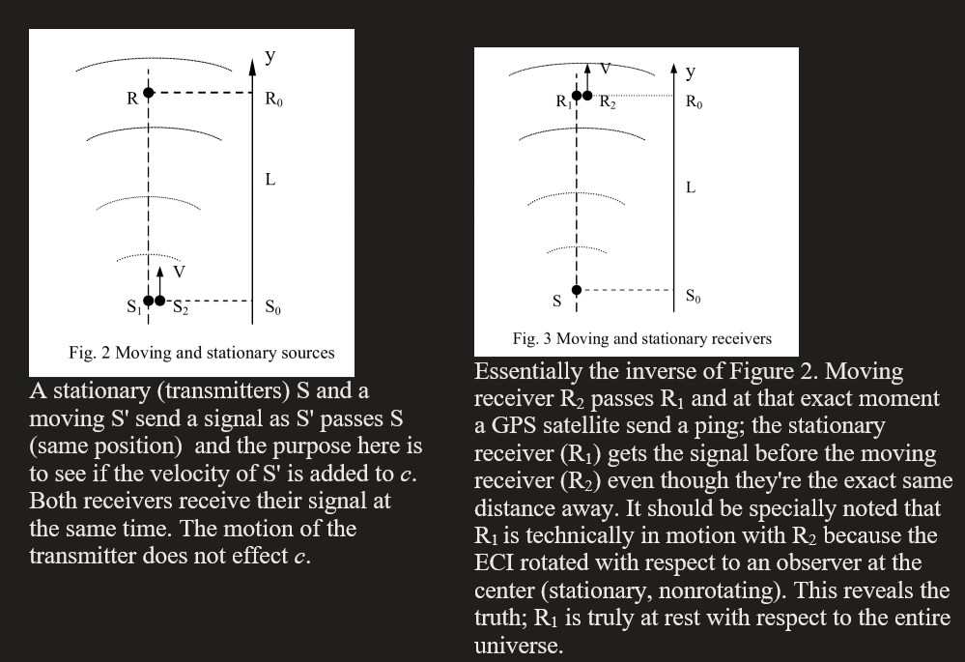
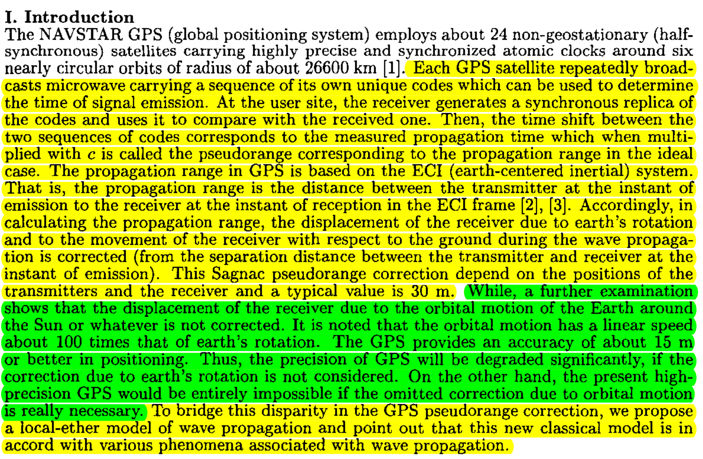
Earth’s Nonexistent orbital velocity
Earth’s assumed, never measured or accounted for orbital velocity: ~30km/s
GPS specifically doesn’t account for the presupposed orbital velocity of the earth around the sun. the orbital motion is a linear speed 100 times that of earth’s rotation and would have to be accounted for in addition to earth’s daily rotation.
The Sagnac effect is revealed in the gps’ range measurement equation as an effect of an ether wind with respect to a stationary, non-rotating earth.
Daily Rotation:
Angular velocity: 15°/h.
Translation speed: 1000,mp/h at the equator. Varies with latitude.
1. Howard C. Hayden, Special Relativity: Problems and Alternatives, Physics Essays, Vol. 8, 3, 1995
2. Ching-Chaun Su, A Local-Ether Model of Wave Propagation Complying with the Sagnac Correction in the Global Positioning System, Antennas and Propagation Society International Symposium, 2000
3.Fig 2. and Fig. 3 (respectively), Ruyong Wang, Re-examine the Two Principles of Special Relativity and the Sagnac Effect Using GPS’ Range Measurement Equation, Pg. 3-4, 2000
4. Stephan Gift, Faster West than East: The GPS Invalidates Special Relativity, Proceedings of the NPA, 2013
Notes:
1. Howard C. Hayden, Special Relativity: Problems and Alternatives, Physics Essays, Vol. 8, 3, 1995
2. Ching-Chaun Su, A Local-Ether Model of Wave Propagation Complying with the Sagnac Correction in the Global Positioning System, Antennas and Propagation Society International Symposium, 2000
3.Fig 3 and Fig 3.Ruyong Wang, Re-examine the Two Principles of Special Relativity and the Sagnac Effect Using GPS’ Range Measurement Equation, Pg. 3-4, 2000

Slide 31
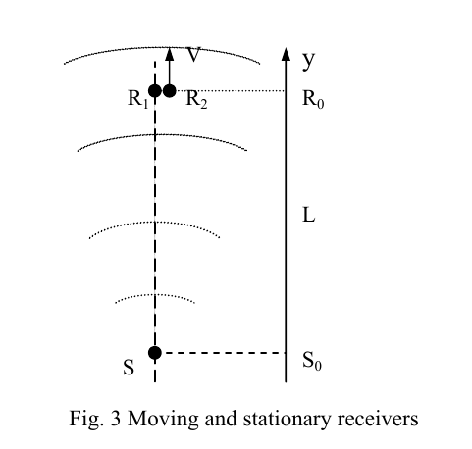
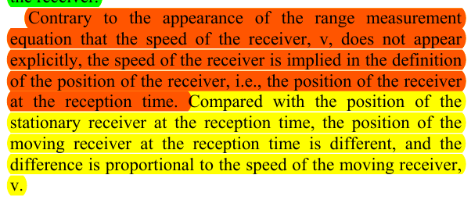
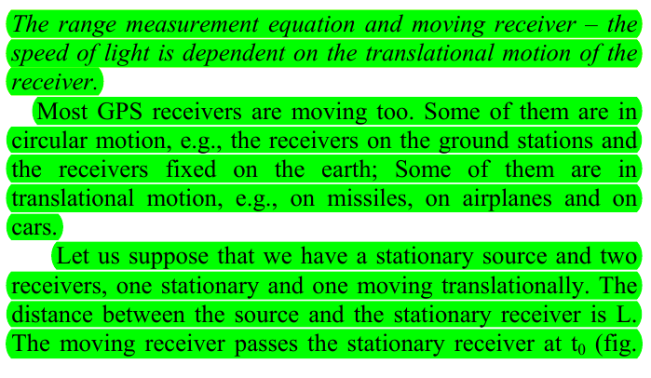
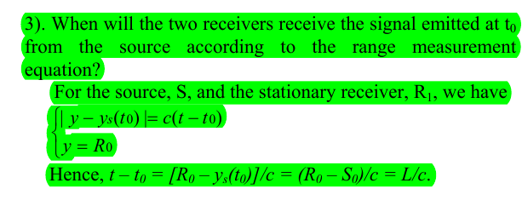
Moving and Stationary Receiver
No orbital velocity correction proportional to the speed increase experienced by Earth rotating into its orbital velocity.
Earth’s rotation is linear. The orbital velocity is linear. If the translational speed of R_2 is proportional to the delay in c, then the orbital velocity must be accounted for, otherwise the RME wouldn’t be accurate down to the millimeter.

Slide 32
TL;DR
Linearized Sagnac effect, i.e. non-rotational effect falsifies SR on the grounds that its postulates regarding reference frames and the constancy of c are not true.
Lorentz Covariance is violated under transformation of distance derived in the ECI using c is shown to be a non-invariant transformation violating the mathematical structure upon which the theory is built.
The Principle of Relativity of Simultaneity is also violated by GPS because it’s a time interval system in which multiple simultaneous events happen relative to other observers regardless of their motion every day, all day. GPS’ accuracy depends on SR not being true.

Slide 33
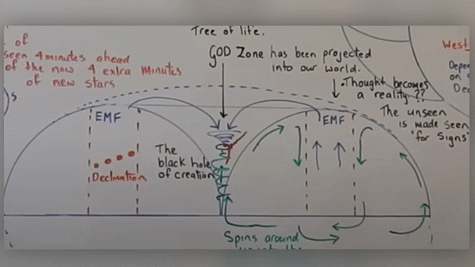
Actual preferred direction East -> West

