Slide 1
The History of “c”
Measuring the “Induction Rate of Light”
- Out of the lab frame
&
- In the lab frame

Slide 2
Timeline
Galileo Galilei (1638) In the lab frame
Ole Roemer (1676) Out of the lab frame
Augustin-Jean Fresnel (1818)
François Arago (1838) In the lab frame
Hippolyte Fizeau (1849) In the lab frame
J.C. Maxwell (1865) In the lab frame
Michelson-Morley (1887)
Albert Einstein (1905) Out of the lab frame [in his head lmao]
Dayton Miller (1926) In the lab frame

Slide 3
Galileo Galilei (1638)
Lantern test
Instant, or too fast to measure

Slide 4
Ole Roemer (1676)
Observed the eclipses of Io, one of Jupiter's moons
Noticed variations in Io's eclipses
Presumed the differences were due to the time it took light to travel different distances to Earth
Deduced a potential finite rate of 220,000 km/sec
26% lower than the currently accepted value of 299,792 kilometers per second

Slide 5
Augustin-Jean Fresnel (1818)
"Mémoire sur la Diffraction de la Lumière" (Memoir on the Diffraction of Light)
Supported a wave theory of light
Developed equations regarding light behavior in various media
Hypothesized the idea that light is dragged by a moving medium

Slide 6
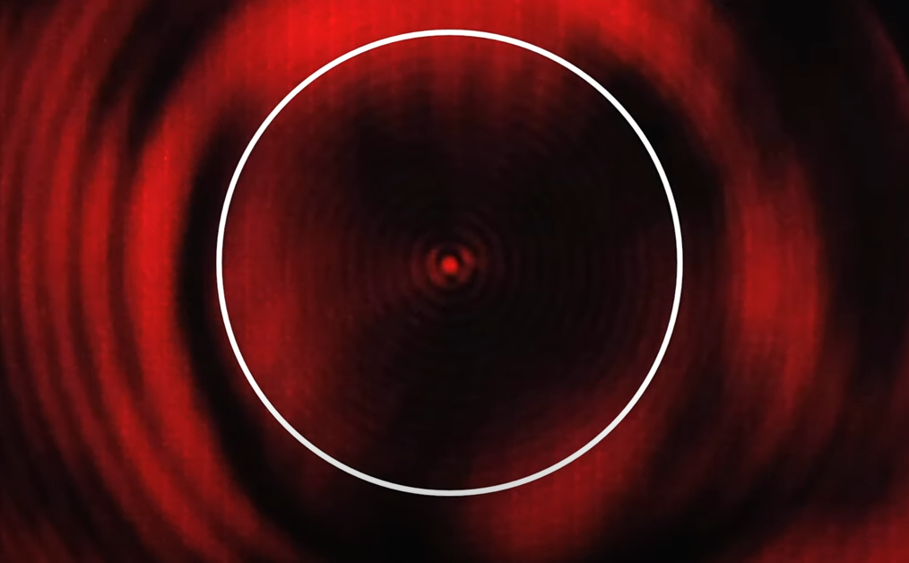
François Arago (1838)
Discovered the “Arago Spot”
Proponent of Wave Theory
Predicted that the induction rate of light should decrease in denser medium​ (Basis of Airy’s Failure)
Determination of “c” in the lab frame

Slide 7
Hippolyte Fizeau (1849)
Determination of “c” in the lab frame with teeth cog
Documented Fresnel Drag tests

Slide 8
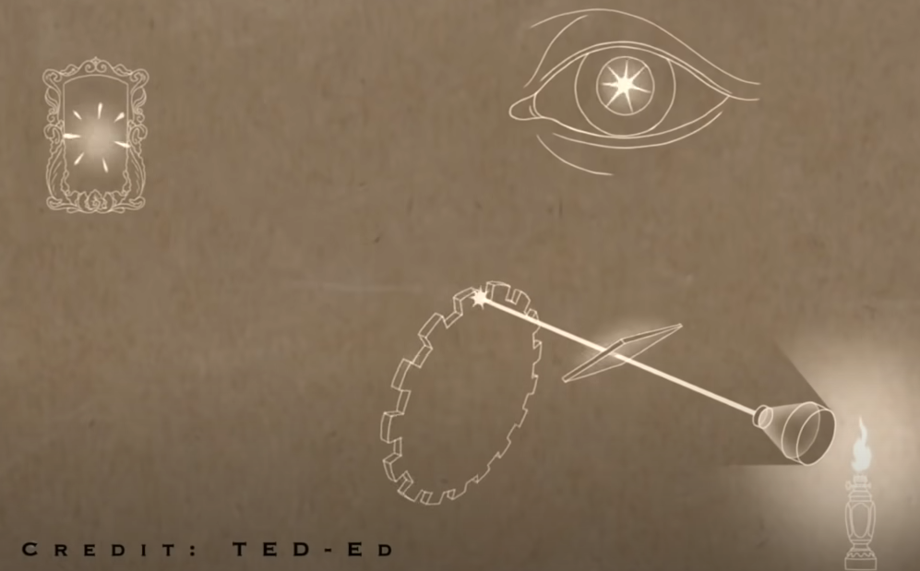

Slide 9
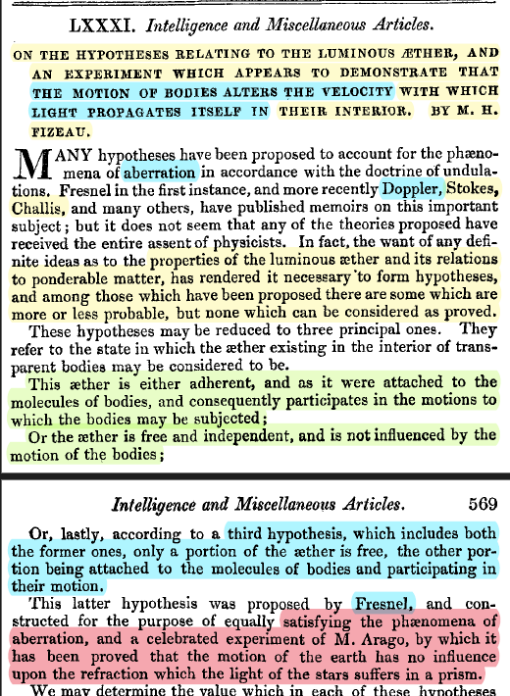
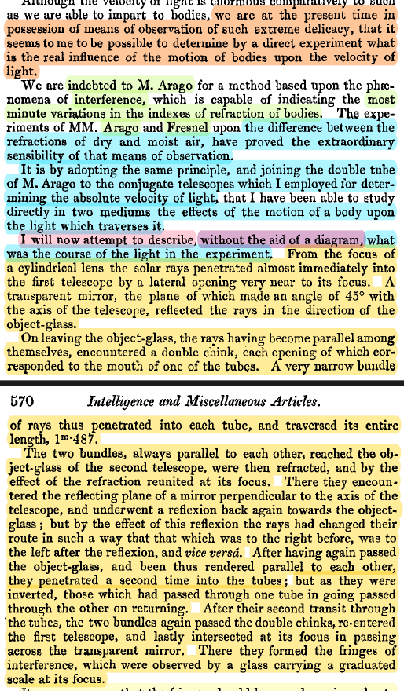

Slide 10
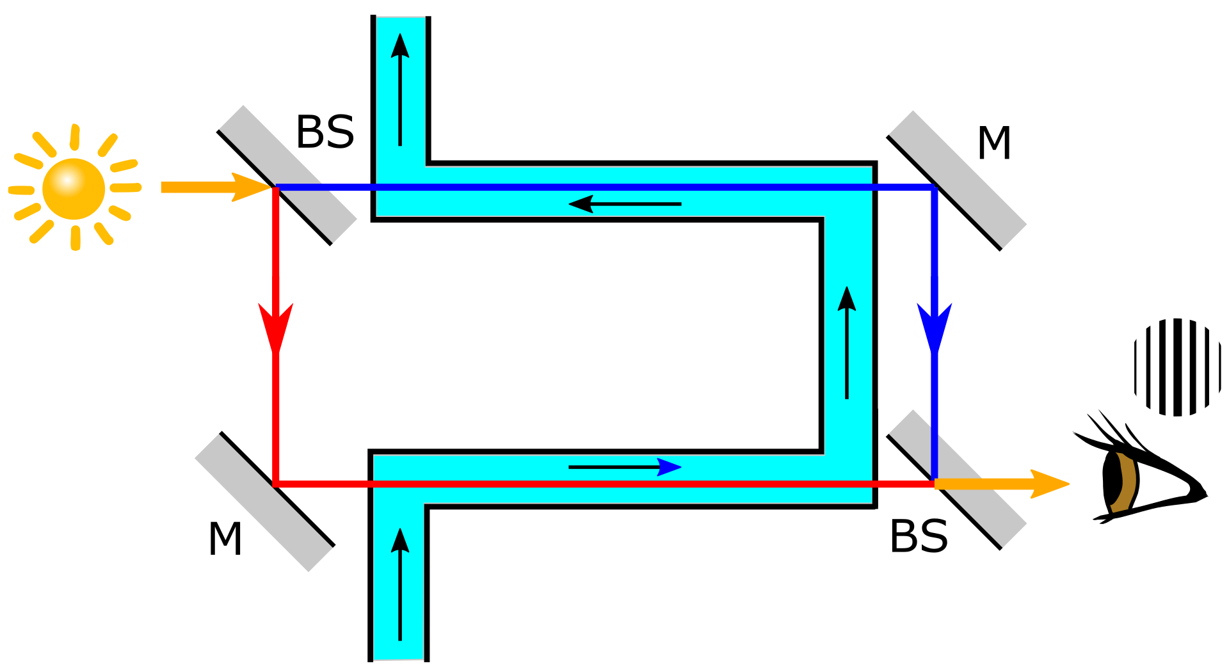
Fresnel Drag
44% Proportional Velocity!

Slide 11
J.C. Maxwell (1865)
Used known values of the electric constant (ε₀) and the magnetic constant (µ₀) in his electromagnetic wave equations
Light is an electromagnetic wave

Slide 12
The Michelson-Morley Experiment
Dependent Variable: “c” or the “speed of light”
Independent Variable: Orthogonal Vector Direction
Result != Copernican Principal
Result can be explained with a stationary Earth and an aether wind

Slide 13
Albert Einstein (1905)
Special Relativity
“Cuz Michelson-Morley!”

Slide 14
Dayton Miller (1926)
Used “c” to measure aether wind
Correlation with altitude and equinoxes = Cannot be rotation

