Slide 2
Doug Marett's YouTube: @plenum88
"Detecting Earth's Diurnal Rotation Using a Large Area Sagnac Interferometer" https://youtu.be/qy_9J_c9Kss

Slide 3
Toronto [Doug Marett] @plenum88
43°39'25.10"N
"Detecting Earth's Diurnal Rotation
Using a Large Area
Sagnac Interferometer“ https://youtu.be/qy_9J_c9Kss

Slide 4
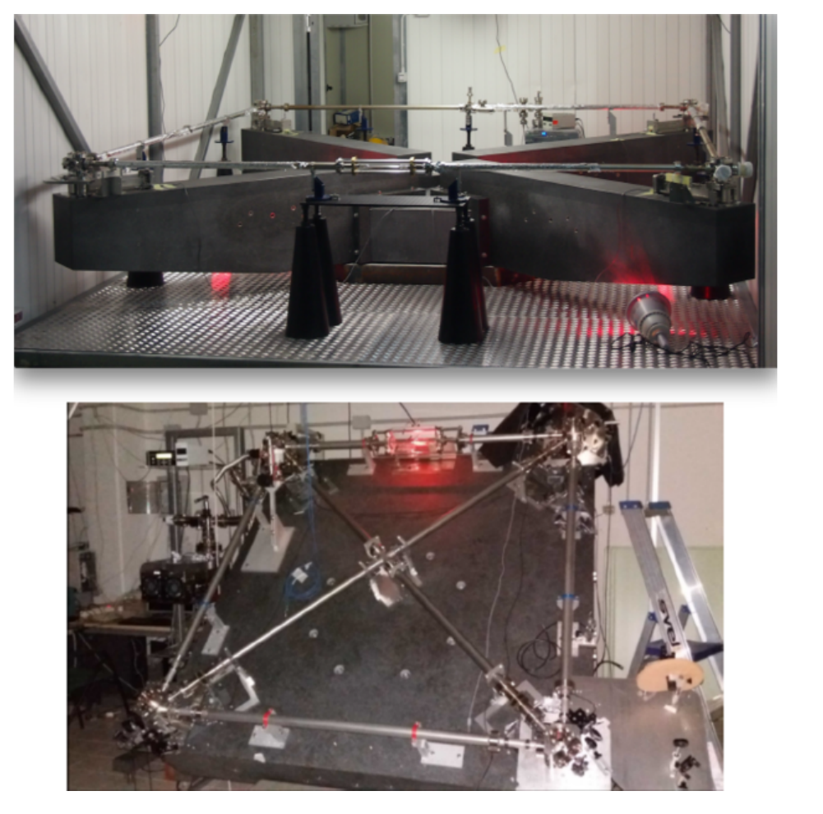

Slide 5
43°43'25.95"N
INFN - Pisa Section [Obs]

Slide 6
Geodätisches Observatorium Wettzell
49° 8'40.90"N

Slide 7
Geometric Properties as Follows:
A vortex extending from the north pole into the Heavens. Outward from that vortex, an all-encompassing uniform motion going East -> West, facilitated by the East -> West sidereal rotation.
“The observation of the optical effect of such an ether wind relative to the
[stationary] ether will constitute a proof of the ether’s existence, just
as the observation of a wind relative to the atmosphere on the speed
of sound in a moving system would constitute — everything else being
equal — a proof of the existence of a stationary atmosphere enveloping
the moving system.” Georges Sagnac, 1913
Within that vortex, a body in motion generates its own ether vortex related to its motion.

Slide 8
Image by Patricia Halliday https://odysee.com/@FindRichardHalliday:1

Slide 9
Image by Patricia Halliday https://odysee.com/@FindRichardHalliday:1

Slide 14
What’s holding back an all encompassing “field” theory? Perhaps all the kinematic abstract mathematics

Slide 15
MISSING: Single Axis Gyro Correction Angles
Have you seen any correction angles and readings featuring a single axis FOG located at the equatorial and/or in the southern hemi? If you have any information regarding the whereabouts of such readings and correction angles to of a single axis FOG located at the equator and/or in the southern hemi, PLEASE contact me at: alanspaceaudits@gmail.com

