Slide 1
On the General Principle of Covariance
The Mathematics history of relativity theory

Slide 2
Definitions:
Covariance: A theory, law or equation that represents a constant remains unchanged under transformation.
Invariance: A physical quantity that remains unchanged under transformation.
“For example, Maxwell’s equations of electrodynamics are covariant under Lorentz transformations (which connect spacetime coordinates of two inertial frames in uniform relative motion) of special relativity, while the charge of an elementary particle is an invariant under the same transformations. This distinction in usage is not always respected; sometimes we speak of ‘invariance’ of a theory instead of ‘covariance’, but clearly there are two distinct notions: one is invariance of ‘form’, the other is invariance of value.”

Slide 3
The mathematics rules for the postulates

Slide 4
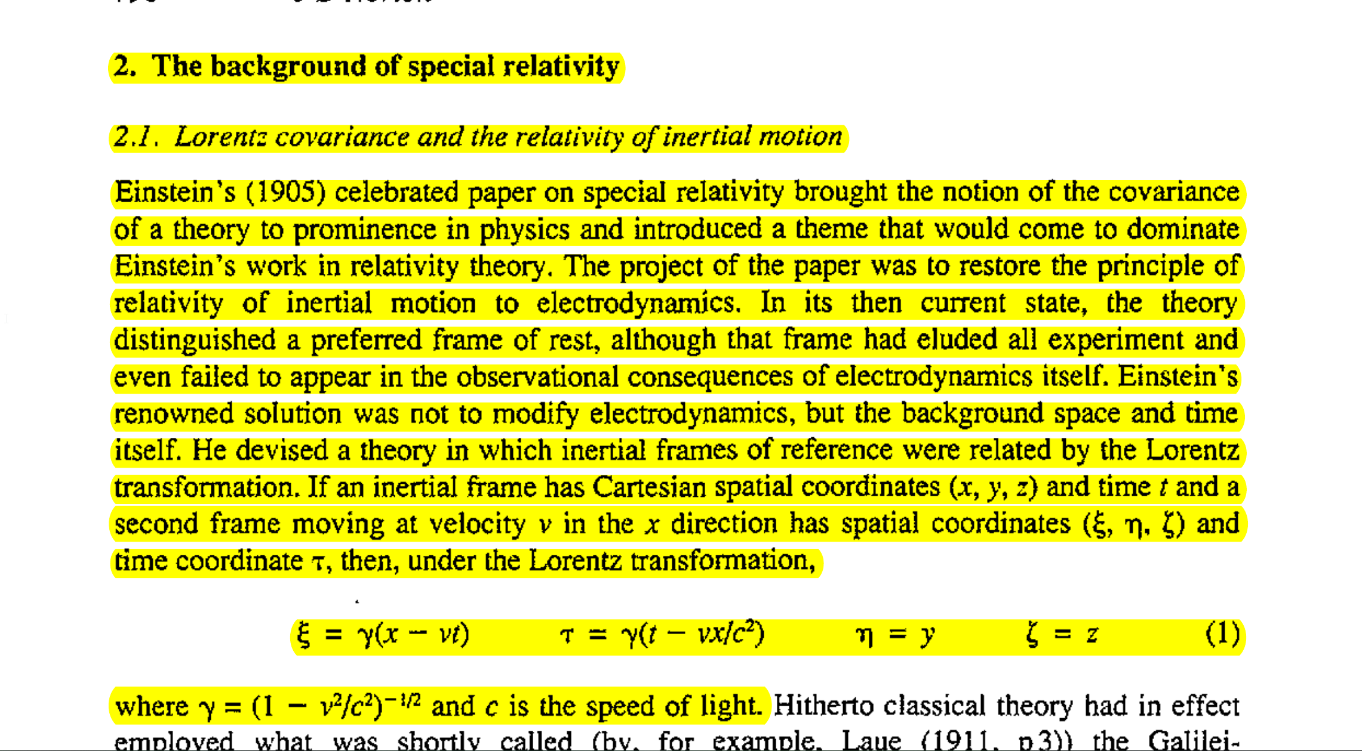
Equation Breakdown:
X - Axis
Y - Axis
Z - Axis
τ – Time Axis
γ (1 – v^2/c^2)^1/2
C – Speed of light
Whatever needs contracted or dilated to conformed to c, that is where the correction will come from.
ξ = γ (x-vt) tells us how much the distance or space must contract relative to the fixed value of c.
τ = γ (t – vx/c^2 tell us how much time must dilate.
For c to remain covariant, t and x must contract and dilate proportionally.

Slide 5
The Goal of Lorentz covariance is for SR to be considered a physically meaningful theory, the theory must show that the laws of physics remain unchanged with respect to Lorentz transformations within the spacetime coordinate system. This is achieved by contracting x and t meet c as seen earlier.

Slide 6
Albert Einstein’s Spacetime Interval
Spacetime interval: ds^2 = -c^2 * dt^2 + dx^2 + dy^2 + dz^2
Einstein's approach to special relativity was more algebraic in nature.
Einstein worked with the coordinate system (contracting or dilating axis) directly and manipulated the equations to express the covariance of physical laws under Lorentz transformations.
The speed of light, denoted by 'c’, is treated as a constant, and the coordinate system itself is adjusted to conform to this constant speed of light. This adjustment of the coordinate system allowed the laws of physics to remain the same for all inertial observers.
Notes:
ds^2 = -c^2 * dt^2 + dx^2 + dy^2 + dz^2

Slide 7
Hermann Minkowski’s spacetime Interval
Spacetime interval: ds^2 = -c^2 * dt^2 + dx^2 + dy^2 + dz^2
Responsible for introducing geometric transformations to relativity theory
Minkowski unified space and time by creating a 4th dimensional spacetime coordinate system where time (t-axis) is always 90 degrees (perpendicular) to the observer’s Space axis (x-axis). When the observer is stationary, time is straight and when the observer is in motion, time is curved. These t-axis lines are known as “worldlines”.
Plotting the worldlines convergence and divergence of the t axis, with respect to each observer creates a hyperbolic relationship that allows you to visually conceptualize the relativistic effects two events in spacetime, i.e., and how they effected by time dilation and length contraction.
This geometric expression of spacetime allows for inherent Lorentz covariance because the spacetime interval used merges time and space. Providing a geometric Transformations explanations as to why observers see events at different times or distances with respect to their motion relative to one another.
Notes:
ds^2 = -c^2 * dt^2 + dx^2 + dy^2 + dz^2

Slide 8
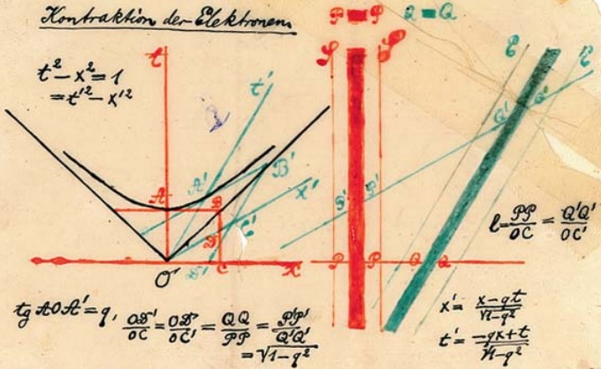
test
Stationary Worldline
Moving Worldline

Slide 9
The joinder of Special and General Relativity
Here Einstein states that motion (energy) is equivalent to gravitational effects.
This is known as the principle of equivalence.

Slide 10
“Absolute Differential Calculus” AKA Tensor Calculus
In 1912 – 1915 Einstein is introduced to absolute differential calculus by his friend Marcel Grossmann
Moving forward, the spacetime intervals, conservation laws and coordinate systems will be described within their respective metric tensors.
Example of Tensors:
Einstein Tensor: G_{μν}
Pseudotensor: T_{μν}
Ricci Tensor: R_{μν}

Slide 11
Einstein’s Field Equations

Slide 12
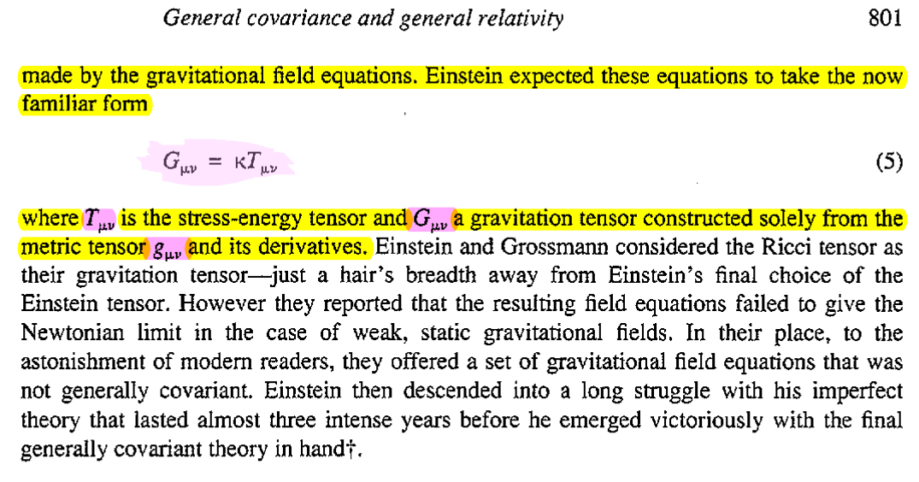

Slide 13
A critique on the methodology of covariance itself: The Illusion
The swapping of metric tensors and spacetime intervals invalidates the constraints covariance attempts to hold on the mathematics of the theory. Simply put, with the derivation of metric tensor any spacetime effect can be invented to conform the coordinate system to c and appear invariant under specific transformations, which defeats the purpose of invariance.
Example: Paul Langevin’s tensor to account for the conservation laws on the small scale to convert rotational energy into time dilation and length contraction.
Einstein’s stress tensor in SR which needed corrections to account for Sagnac
Langevin-Landau-Lipshift Metric to satisfy the initial stress tensor because it’s a first-order intrinsic invariant differential

Slide 14
Stephen Crothers
Analysis of Einstein’s stress tensor which was entirely derived from the spacetime interval metric.

Slide 15
Definitions:
Tensor: A mathematical object that represents a linear relationship between sets of vectors, scalars, and other tensors.
Pseudotensor: A tensor-like object that transforms like a tensor under some transformations but not under others.
First order intrinsic differential Invariant: A type of invariant tensor that is coordinate dependent and changes under transformations; it is composed solely of the components of a tensor and its first derivatives. It is not derived from the field equations themselves and cannot be obtained from second-order field equations, which violates the mathematical structure of the theory based on the principle of covariance and the idea that physical laws should be independent of the choice of coordinate system.
Contraction: A mathematical operation that involves summing over the components of a tensor in a specific way to extract information about the state of the system the tensor is describing.
Conservation of energy and momentum: A physical principle that states that the total energy and momentum in a closed system are conserved over time. In relativity theory, gravitational fields and spacetime curvature tend to infinity, which violates the conservation of energy and momentum.
Second-order differential equation: A second-order differential equation is a mathematical equation that involves a function, its derivatives, and its second derivatives. Einstein's field equations are second-order differential equations that describe the relationship between spacetime curvature and the distribution of matter and energy within it. The curvature of spacetime is affected by the presence of matter and energy, and the field equations provide a framework for understanding this relationship.

Slide 16
test

